Slide 1
Voice Style Transfer
William Corsel (2049481) & Wouter Stokman (2025418)
Code: https://github.com/Woutah/API
Audio samples: https://woutah.github.io/API/

Slide 2



Motivation
Voice Conversion: Modify source speech to make it sound like it is being spoken by another speaker
“Cool”
Source
“Cool”
Applications:
Privacy and identity protection
Creative industry
Conversion
“Nice”
Target
Notes:
The goal presented in this paper is to create a voice conversion system which can modify speech from a source speaker to make it sound like it is being spoken by a different speaker.
In this example we have a source speaker that says the word “cool”, and a target speaker that says the word “Nice” in a different voice. The goal of voice conversion is to make the source speaker say the word “cool” but with the voice of the target speaker.
This can be useful for applications like privacy and identity protection or in the creative industry

Slide 3
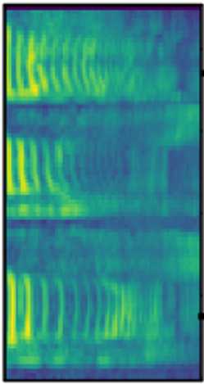
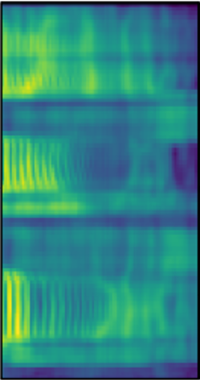
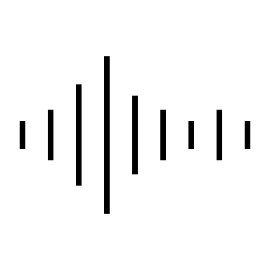
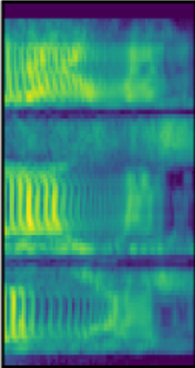
Framework: AutoVC
Autoencoder structure
Easy to train!
Mel-Spectrograms
Mel-Spectrograms
AutoVC
Source
Converted
Preprocessor
Content
Encoder
Decoder
Vocoder
Target
Preprocessor
Speaker
Encoder

Slide 4

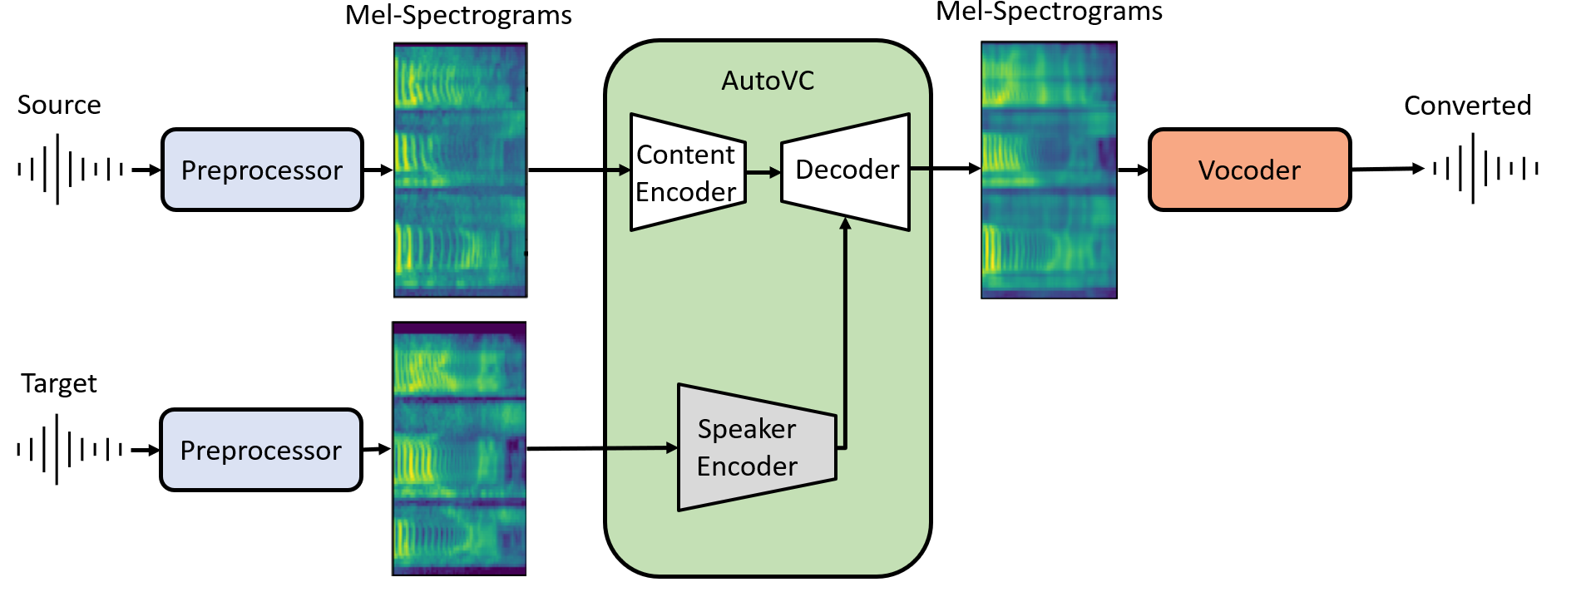

Framework: AutoVC
However:
Slow Vocoder (10 minutes)
Trained on small subset of VCTK
Limited sample size (1.4 sec)
Solution:
“Chunking”
Vocoder
Retraining
Combination
Original
p225→p225 (full)
p225→p225 (chunk)
p225→p226 (chunk)
p225→Wouter

Slide 5
Framework: Pretrained AutoVC + Griffin-Lim
Mel-Spectrograms
Mel-Spectrograms
AutoVC
Source
Converted
Preprocessor
Content
Encoder
Decoder
Griffin-Lim
Target
Preprocessor
Speaker
Encoder
P225 -> p226

Slide 6
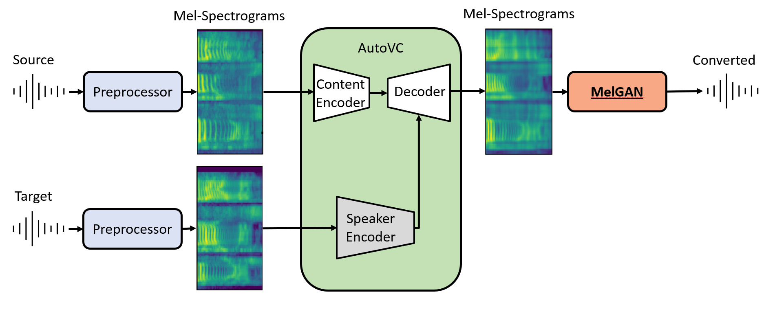
Framework: Pretrained AutoVC + MelGAN
p225 -> p226
MelGAN pretrained on VCTK. However…
Mel spectrogram mismatch

Slide 7
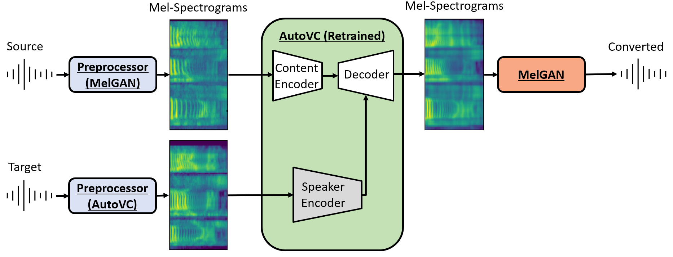
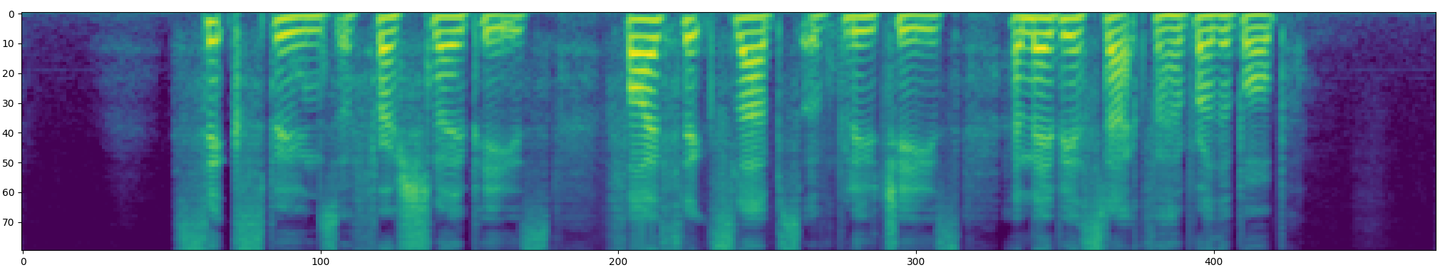
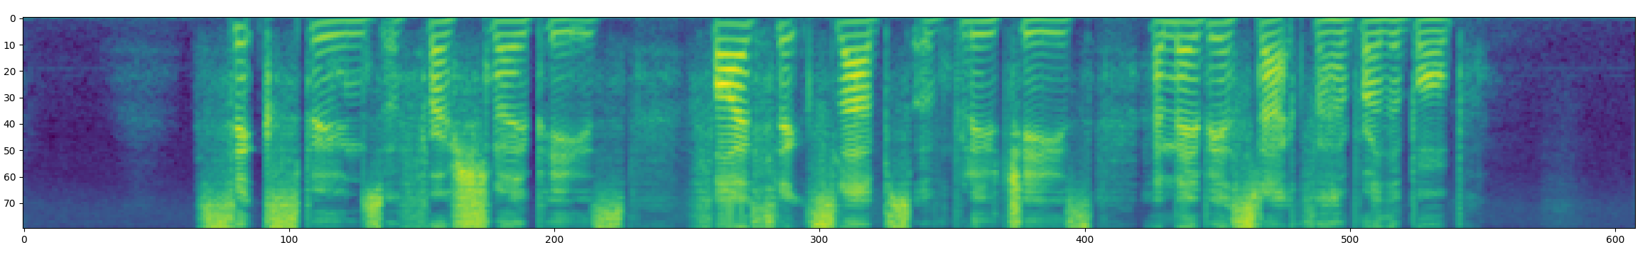
Vocoder: Multi-band Melgan
(Much) Faster
Real time conversion(!)
However:
Preprocessing
Mel-spectrogram
AutoVC Retraining
Longer samples ( 128 512 )
MelGAN Preprocessing
Untrained
p226
Wouter
MelGan:
p225 → p226
p226 → Wouter
Wouter → p226
WaveNet:

Slide 8
LIVE DEMO

Slide 9
Conclusions & Future Work
AutoVC shows impressive results on seen data
Not so great on unseen speakers?
MelGAN vocoder used to significantly speed up inference
Retrained AutoVC + MelGAN → Real-time conversion!
Future work
Retrain speaker encoder for streamlined preprocessing
Improve live streaming program

Slide 10
Voice Style Transfer
William Corsel (2049481) & Wouter Stokman (2025418)
Code: https://github.com/Woutah/API
Audio samples: https://woutah.github.io/API/

Slide 11
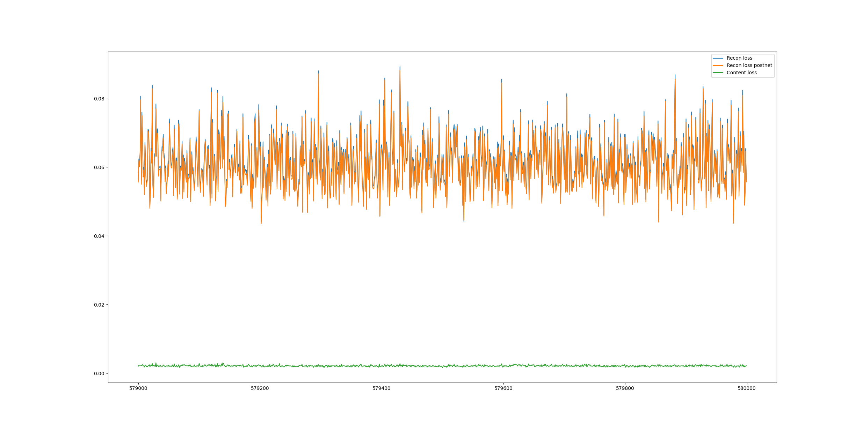

Slide 12
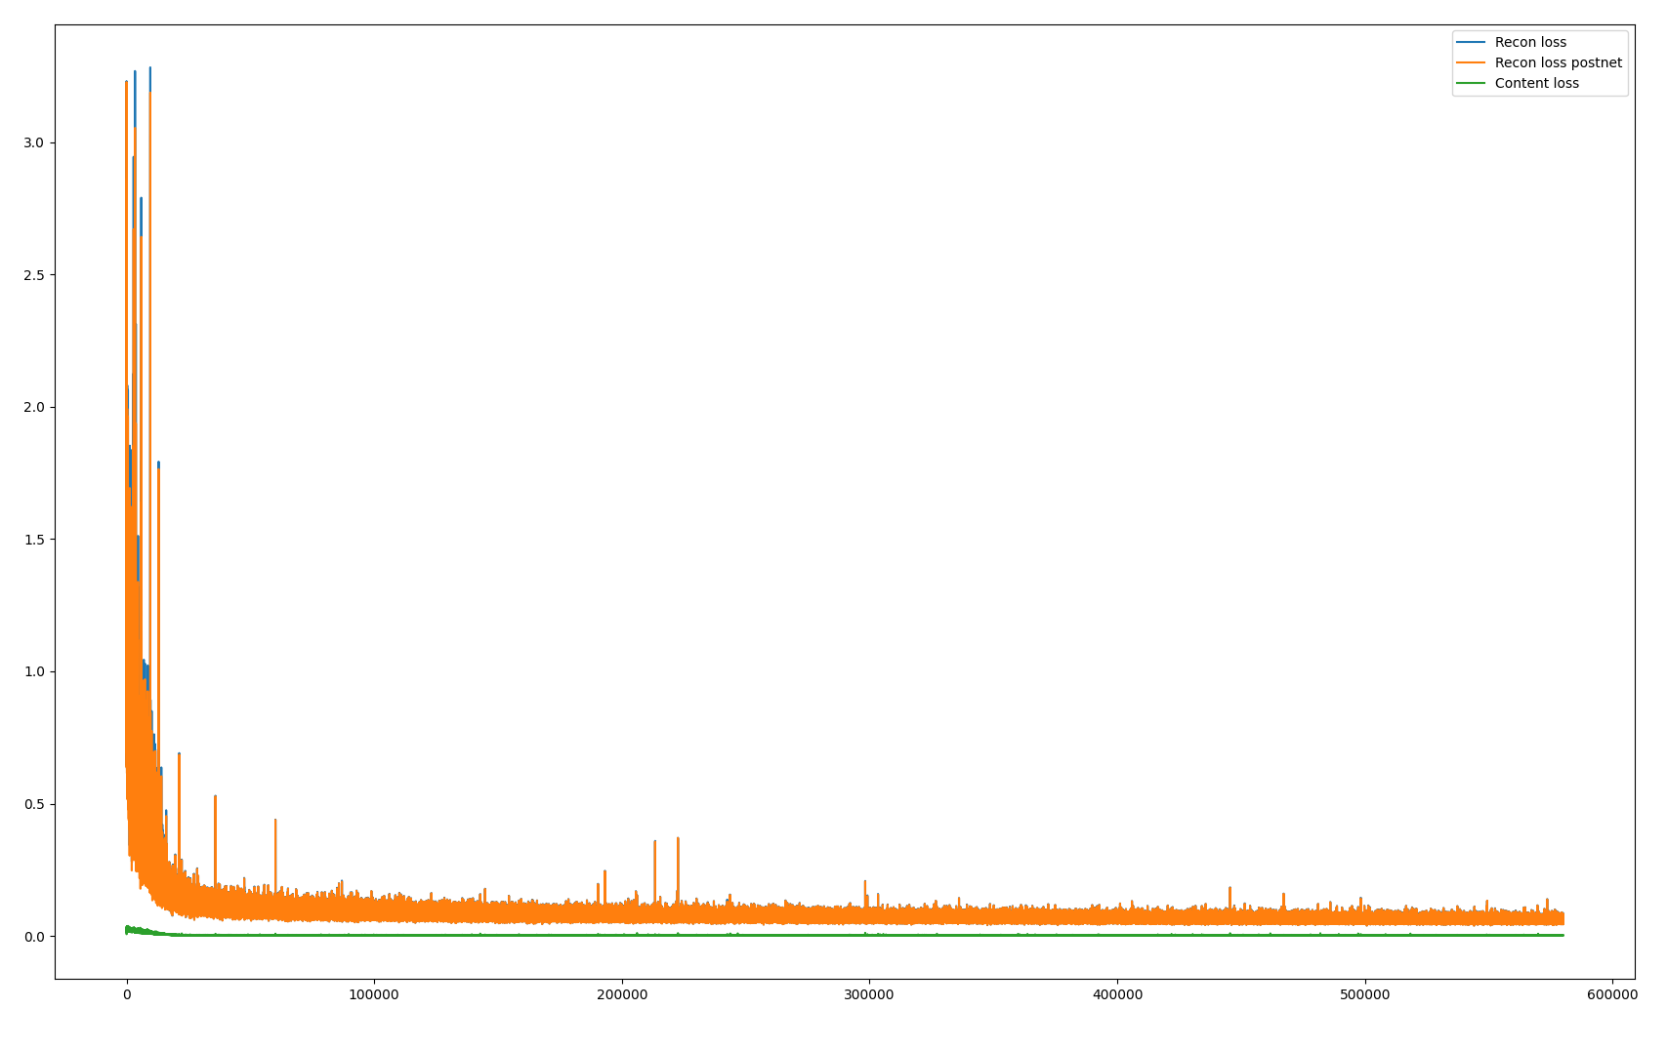

Slide 13
Framework: Retrained AutoVC + MelGAN
Mel-Spectrograms
Mel-Spectrograms
AutoVC (Retrained)
Source
Converted
Preprocessor
(MelGAN)
Content
Encoder
Decoder
MelGAN
Target
Preprocessor
(AutoVC)
Speaker
Encoder

Slide 14
Framework: Pretrained AutoVC + MelGAN
Mel-Spectrograms
Mel-Spectrograms
AutoVC
Source
Converted
Preprocessor
Content
Encoder
Decoder
MelGAN
Target
Preprocessor
Speaker
Encoder

Slide 15
Framework: Pretrained AutoVC + WaveNet
Mel-Spectrograms
Mel-Spectrograms
AutoVC
Source
Converted
Preprocessor
Content
Encoder
Decoder
Griffin-Lim
Pretrained models:
Speaker encoder: VoxCeleb1 & LibriSpeech
AutoVC: VCTK
WaveNet: VCTK
Target
Preprocessor
Speaker
Encoder
Original
p1→p1 (full)
p1→p1 (chunk)
p1→p2 (chunk)
p1→Wouter

